Slide 1




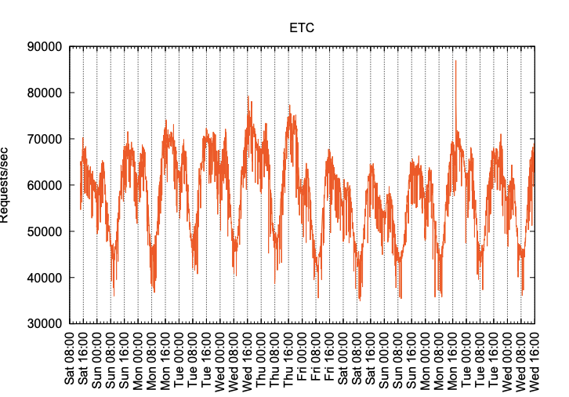


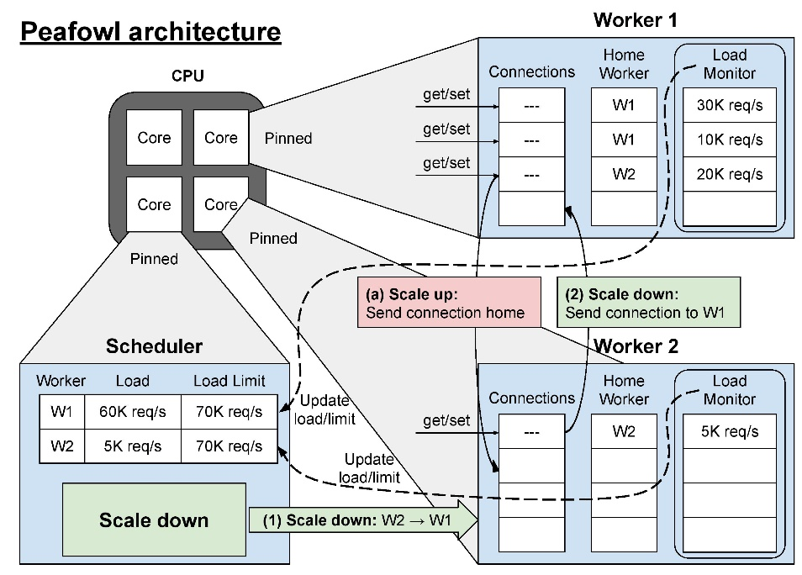
Peafowl: In-application CPU Scheduling to Reduce Power Consumption of In-memory Key-Value Stores
Peafowl: In-application CPU Scheduling to Reduce Power Consumption of In-memory Key-Value Stores
Showan Esmail Asyabi, Azer Bestavros (Boston University), Erfan Sharafzadeh (Johns Hopkins University), Timothy Zhu (The Pennsylvania State University)
PROBLEM AND MOTIVATION
Problem and Motivation
Peafowl Design
Peafowl in Action
Diurnal pattern of KV store workloads in Facebook ETC datacenter
Worker Thread
Scheduler Thread
Serve user requests
Schedule connections
Tail latency of key-value (KV) stores impacts the overall performance of high-fanout applications
Learn the peak load
Monitor workers’ loads
Monitor the load
Identify off-peak periods
Instantly scale-up when load peaks
Gradually pack load among
fewer cores
KV store workloads have a diurnal pattern
Application
Service providers provide for peak load to ensure low tail latency
OS
Problem: High energy consumption of ever-growing in-memory KV stores (i.e., cache nodes) in data centers
Idle-state governor is active on idle cores
Idle-state governor is inactive on active cores
Goal: Save power during off-peak periods while ensuring microsecond scale tail latency
Idea: Perform scheduling in the KV store to unbalance the load during off-peak periods
Peafowl saves 36% more power while keeping tail latency at microsecond scale
Existing Solutions
Peafowl Implementation
Peafowl Compared to Existing Approaches
Idle-state governor: Force CPU into deep idle states
Problem: Short interarrival fragments idle periods
Feedback-based controllers: Monitor the load and adjust the number of allocated cores
Problem: Controllers rely on OS for scheduling→ too slow
DVFS and request delaying: Exploit the latency gap to slow down the request processing
Problem: Due to the high arrival rate and short service time of KV store workloads, these approaches are not able to notably save power
The high arrival rate, short service time, and tight latency requirements make existing solutions less effective
Open sourced at https://github.com/showanasyabi/peafowl-kvs
Peafowl outperforms Rubik, µDPM, and a Clairvoyant idle-state governor with up to 40%, 54%, and 45% more power savings respectively

